Slide 1

HOUSING PRICE INDEX(HPI)
Dhruv Mistry
Madhavi Terdal
Mohammed Hassan
Pruthvi Baria

Slide 2
What is HPI
A house price index (HPI) measures the price changes of residential housing as a percentage change from some specific start date (which has HPI of 100).
Methodologies commonly used to calculate a HPI are the hedonic regression (HR), simple moving average (SMA) and repeat-sales regression (RSR)

Slide 3
Cities included
San Francisco
New York City
Chicago

Slide 4
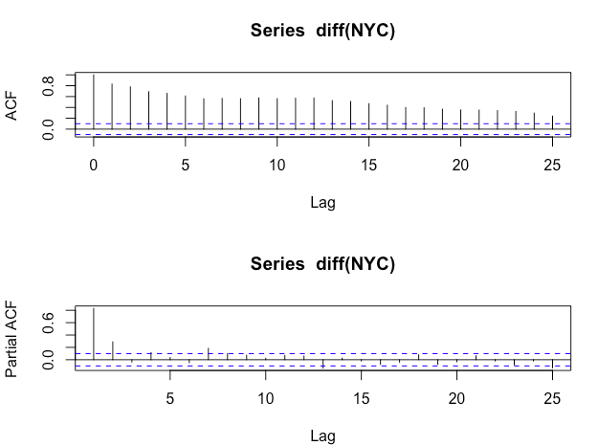
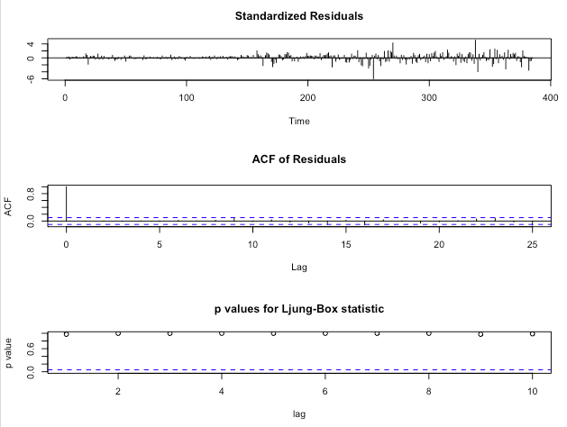
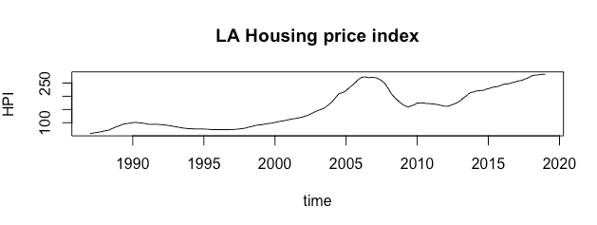
ARIMA MODELS FOR SAN FRANCISCO

Slide 5
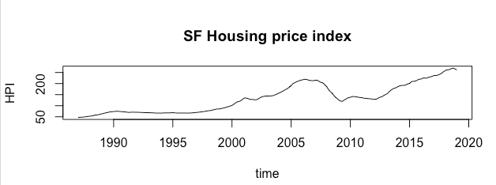
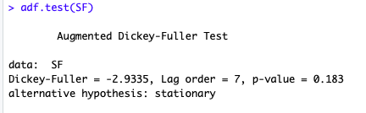
STEP 1: Plot the time series for SF Housing Price Index
STEP 2: Check for stationarity using Dickey Fuller Test

Slide 6
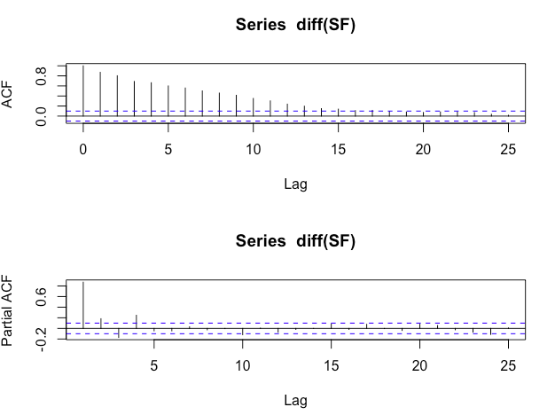
STEP 3: Plot ACF and PACF to get the ARIMA ORDER

Slide 7
STEP 4
Goodness of Fit

